Slide 1
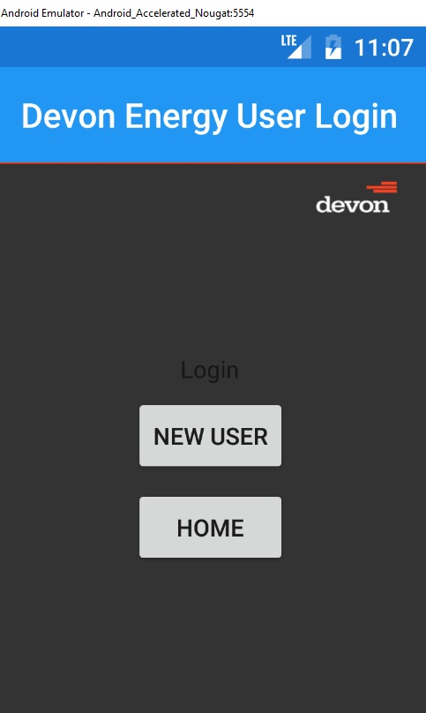

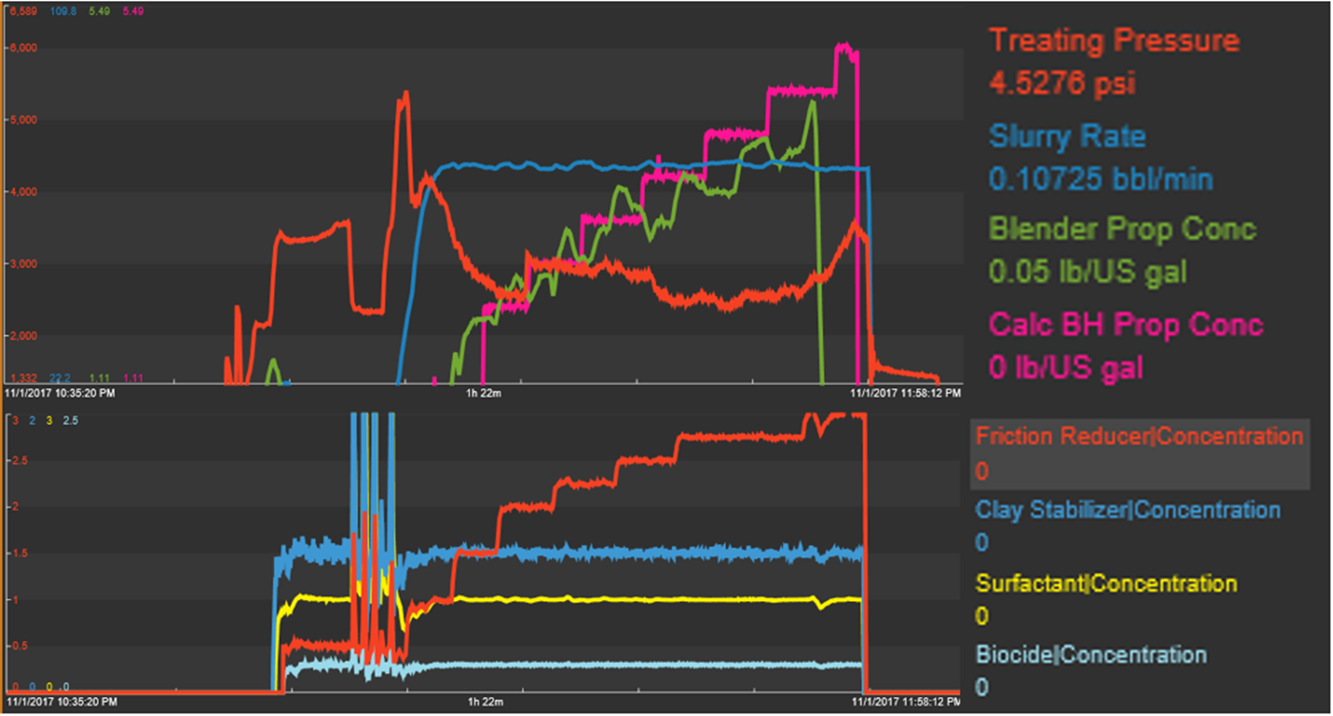
Devon’s Completion App
Wireframe and visualization
Our app focuses on two personas - (1) the person in charge (PIC) and (2) and also those in the business responsible for project economics that would include wells that are being completed in the field and wells already producing in the same field.
Screen 1
Screen 2
Basic Functionality
Current sensor reading
Well bore locations & key mechanical details stage info including timeclock
Screen-out warnings
Sensor measurement from offset wells
Formation characteristics of current location in wellbore
PIC ID: 77888777
Site #: 25
Location: YYZ
Frac. Data Summary
Alerts
Historical Data
By Stage
Support & Help
Game
Start Video Chat
Aspirational features
Notes:
Enhanced Functionality: Project View (Field Impact vs. Well Impact)
Incremental financial improvement of fracking process using integrated machine learning

